Slide 1
VAR

Slide 2
VAR
Data used to fit
the first model
Data used to fit
the second model
The first
prediction
The second
prediction
T1
T1+1
T1+2
T2
T1 is the last datum in the first 3.5 years
T1+1 is the first datum in the last 1.5 years
T2 is the last datum in the test sample
First 1.5 Years
Last 1.5 Years

Slide 3
Currency Index
Time
Index
0
1
2
3
4
5
6
7
8
(0)
(1)
………………….…………………………..
(8)
t=p
Yp
logRVp
logRVp
logRVp
Data used to fit
the first model
t=p+1
Yp+1
(0)
(1)
………………….…………………………..
(8)
logRVp+1
logRVp+1
logRVp+1
Data used
to fit the
second model
…......…
…......…
…......…
…......…
…......…
…......…
…......…
Y
=
=
(0)
(1)
………………….…………………………..
(8)
t=T1
YT1
logRVT1
logRVT1
logRVT1
YT1+1
(0)
(1)
………………….…………………………..
(8)
Data used
to fit the
last model
t=T1+1
logRVT1+1
logRVT1+1
logRVT1+1
t=T1+2
YT1+2
(0)
(1)
………………….…………………………..
(8)
logRVT1+2
logRVT1+2
…...
…...
…...
logRVT1+2
…...
…...
…...
…...
t=T2-1
YT2-1
(0)
(1)
………………….…………………………..
(8)
logRVT2-1
logRVT2-1
logRVT2-1
YT2
(0)
(1)
………………….…………………………..
(8)
t=T2
logRVT2
logRVT2
logRVT2
The prediction
made by
the last
fitted model
The prediction
made by
the first
fitted model
The prediction made by
the second
fitted model

Slide 4
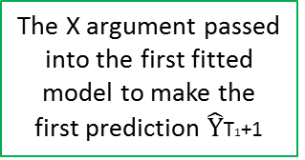
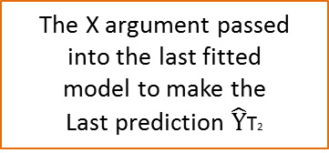
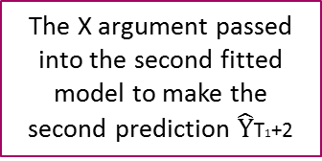
Currency Index
0
…………………………………..….………..
8
Time
Index
(0)
…
(0)
………………….………..
(8)
…
(0)
t=p
Xp-1
logRVp-1
logRV0
logRVp
logRV0
Data used to fit
the first model
(0)
(0)
………………….………..
(8)
(0)
t=p+1
Xp
logRVp+1
…
logRV1
logRVp+1
…
logRV1
…......…
…......…
…......…
Data used
to fit the
second model
…......…
…......…
…......…
…......…
X
=
=
(0)
…
(0)
………………….………..
(8)
…
(0)
t=T1
XT1-1
logRVT1-1
logRVT1-p
logRVT1
logRVT1-p
XT1
(0)
…
(0)
………………….………..
(8)
…
(0)
Data used
to fit the
last model
t=T1+1
logRVT1
logRVT1-p+1
logRVT1+1
logRVT1-p+1
t=T1+2
XT1+1
(0)
…
(0)
………………….………..
(8)
…
(0)
logRVT1+1
logRVT1-p+2
logRVT1+2
logRVT1-p+2
…...
…...
…...
…...
…...
…...
…...
(0)
…
(0)
………………….………..
(8)
…
(0)
t=T2-1
XT2-2
logRVT2-1
logRVT2-1
logRVT2-1
logRVT2-1
(0)
…
(0)
………………….………..
(8)
…
(0)
t=T2
XT2-1
logRVT2
logRVT2
logRVT2
logRVT2
The X argument passed into the first fitted
model to make the
first prediction $\hat{Y}$T1+1
The X argument passed into the second fitted
model to make the
second prediction $\hat{Y}$T1+2
The X argument passed into the last fitted
model to make the
Last prediction $\hat{Y}$T2

Slide 5
LASSO / Ordered LASSO

Slide 6
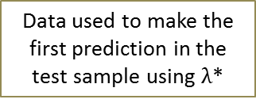
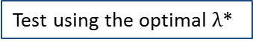
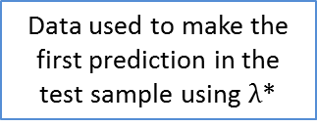
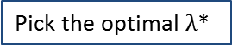
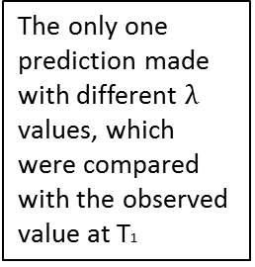
LASSO / Ordered LASSO
The only one prediction made with different $λ$ values, which were compared with the observed value at T1
Data used to fit the model using $λ_{1}$ in the test sample
The first prediction
made in the
test sample
Data used to fit the model using $λ_{2}$ in the test sample
…
Data used to fit the model using $λ_{n}$ in the test sample
The second prediction
made in the
test sample
…
T1-1
T1
T1+1
T1+2
T2
Data used to make the
first prediction in the
test sample using $λ$*
Data used to make the
first prediction in the
test sample using $λ$*
Training Sample
(first 1.5 years)
Test Sample
(last 1.5 years)
Pick the optimal $λ$*
Test using the optimal $λ$*
T₁ is the last datum in the training sample
T₁+1 is the first datum in the test sample

Slide 7
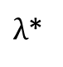
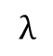
LASSO / Ordered LASSO
MSE
$λ$*
$$λ$$

Slide 8
KNN

Slide 9
KNN
Data used to fit the
first model in the
training sample
The first prediction
made in the
training sample
Data used to fit the
first model in the
test sample
The first prediction
made in the
test sample
100
101
T1
T1+1
T2
T₁ is the last datum in the training sample
T₁+1 is the first datum in the test sample
Skip the first 100 data
Training Sample
(first 1.5 years)
Test Sample
(last 1.5 years)
Pick the optimal k*
Test using the optimal k*

Slide 10
KNN
MSE
K*
k

Slide 11
HW3

Slide 12
MSE
∆*
∆

Slide 13
Results - Ordered LASSO

Slide 14
Results Summary
For the results summarized below, please note that
For the plot on the left , the axis is Lambda
Lambda Values=c(seq(0.01,2,0.01),c(3,400,1))
For the plot on the right, the axis is log(Lambda)
- Lambda Values=c(exp(seq(-10,0,0.05)),seq(1.01,2,0.01),seq(3,400,1))
For the table on the left , the optimal lambda’s are obtained using
Lambda Values=c(seq(0.01,2,0.01),c(3,400,1))
For the plot on the right, the optimal lambda’s are obtained using
- Lambda Values=c(exp(seq(-10,0,0.05)),seq(1.01,2,0.01),seq(3,400,1))

Slide 15
P=1

Slide 16
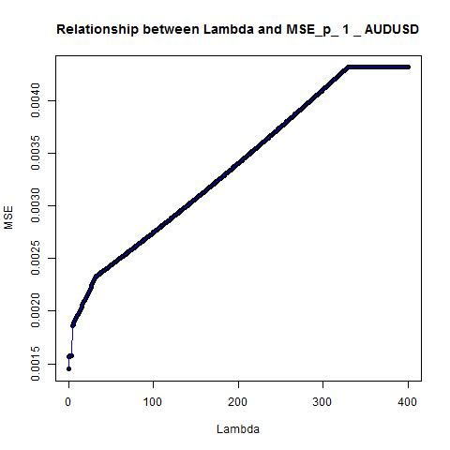
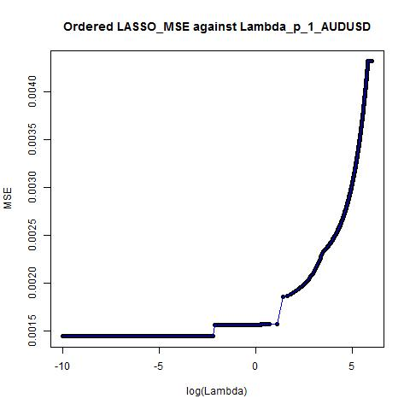
Optimal Lambda ≈ 0.01
Optimal Lambda ≈ 0.0000454

Slide 17
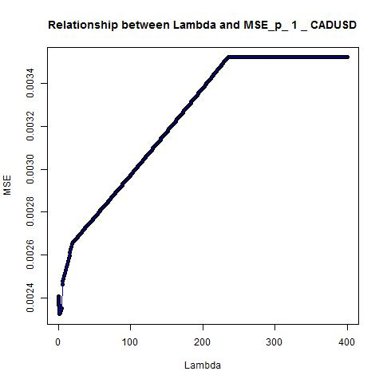
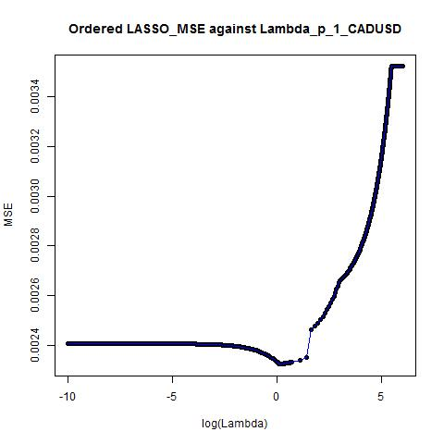
Optimal Lambda ≈ 1.11
Optimal Lambda ≈ 1.11

Slide 18
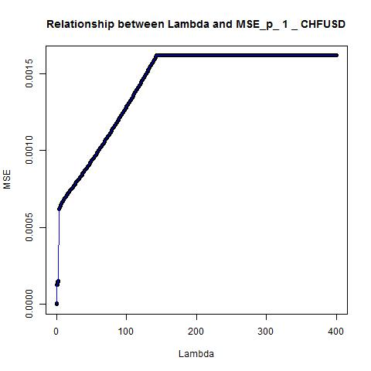
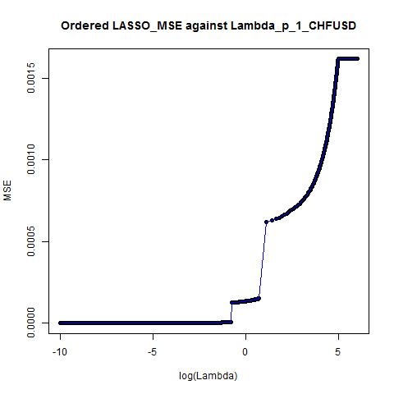
Optimal Lambda ≈ 0.07
Optimal Lambda ≈ 0.0672055

Slide 19
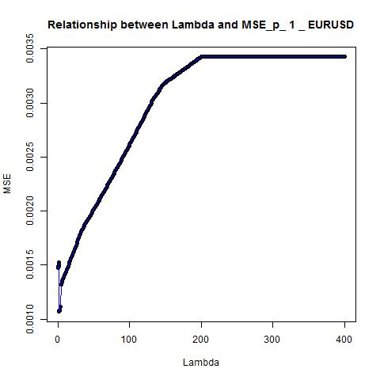
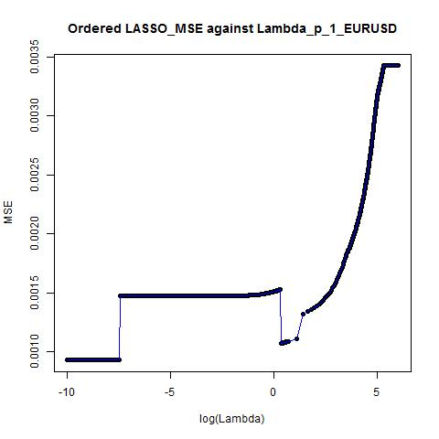
Optimal Lambda ≈ 1.38
Optimal Lambda ≈ 0.0000454

Slide 20
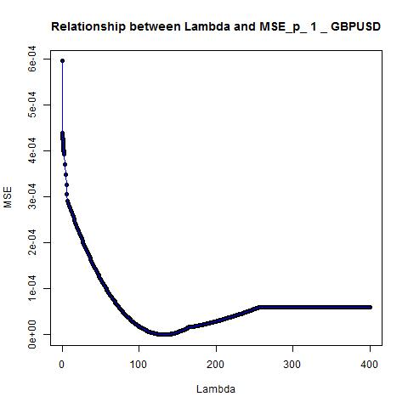
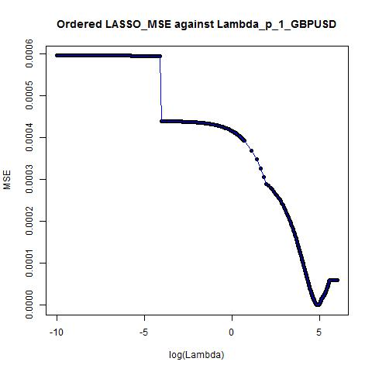
Optimal Lambda ≈ 132
Optimal Lambda ≈ 132

Slide 21
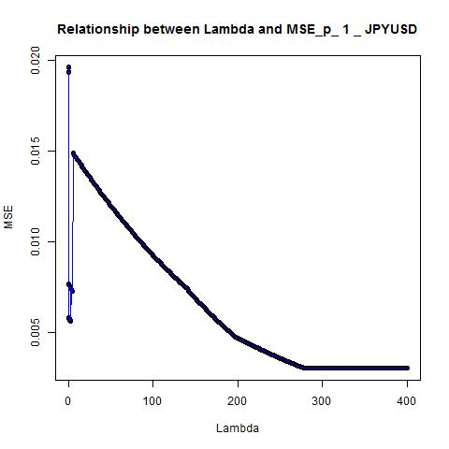
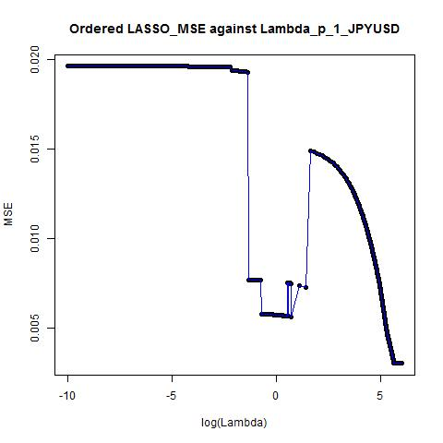
Optimal Lambda ≈ 400
Optimal Lambda ≈ 400

Slide 22
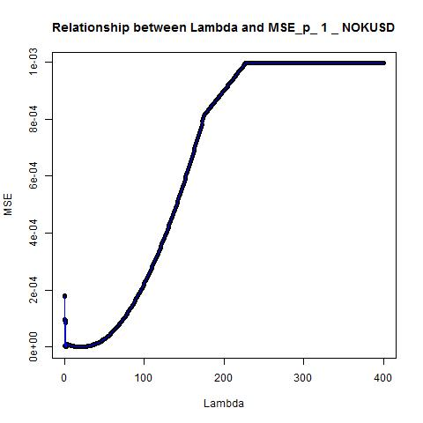
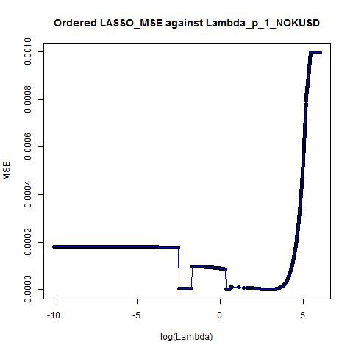
Optimal Lambda ≈ 20
Optimal Lambda ≈ 20

Slide 23
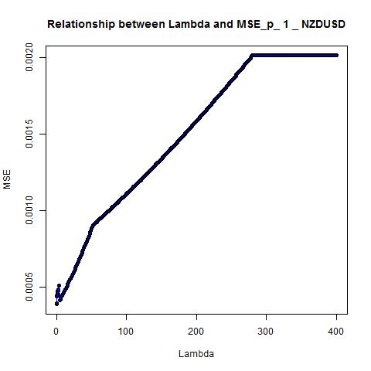
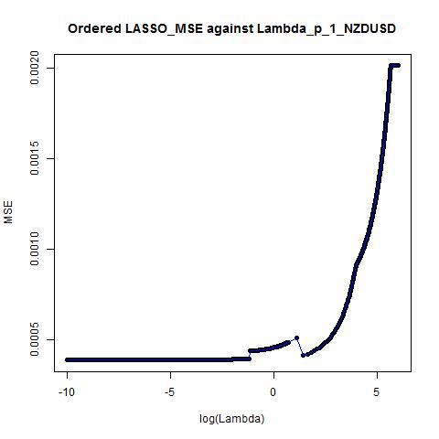
Optimal Lambda ≈ 0.01
Optimal Lambda ≈ 0.0000454

Slide 24
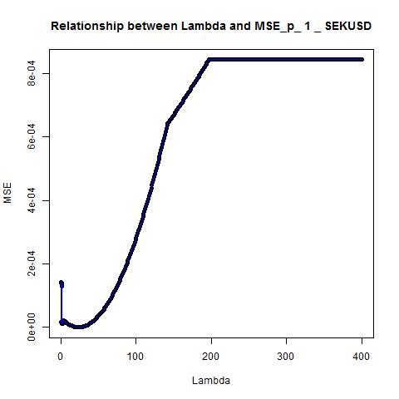
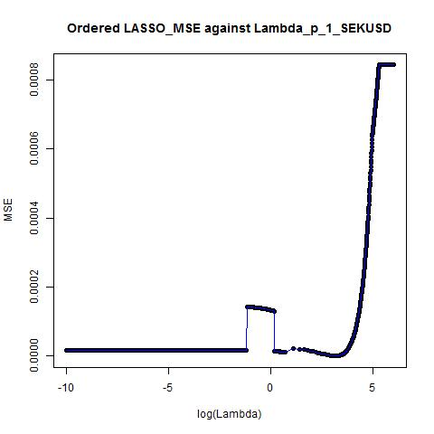
Optimal Lambda ≈ 23
Optimal Lambda ≈ 23

Slide 25
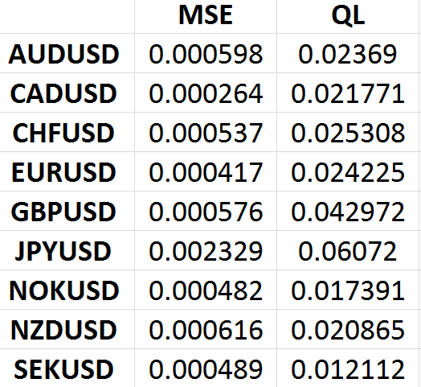
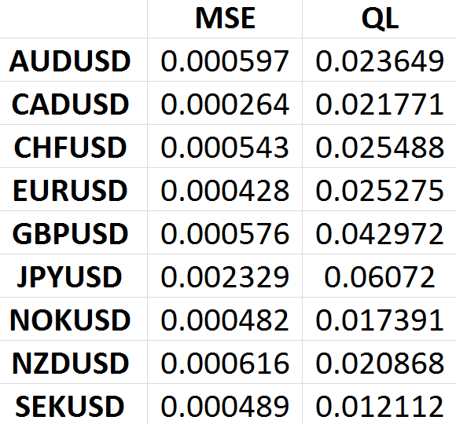
P=1

Slide 26
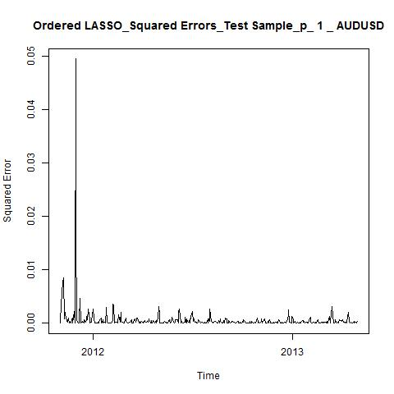
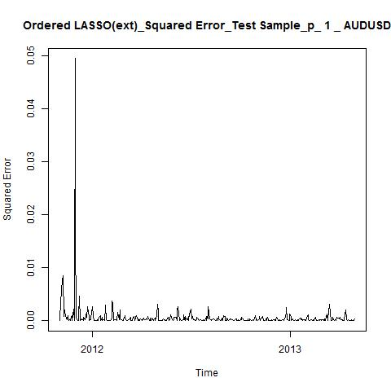
Optimal Lambda ≈ 0.01
Optimal Lambda ≈ 0.0000454

Slide 27
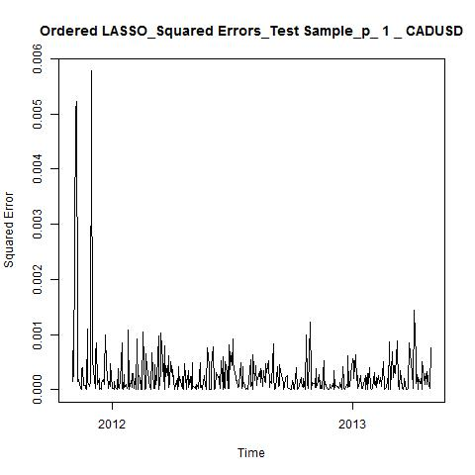
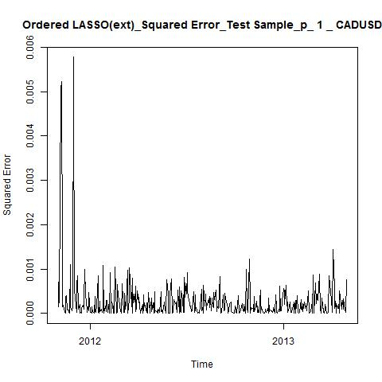
Optimal Lambda ≈ 1.11
Optimal Lambda ≈ 1.11

Slide 28
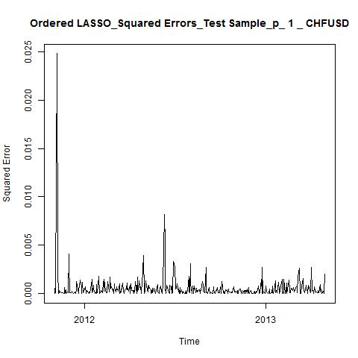
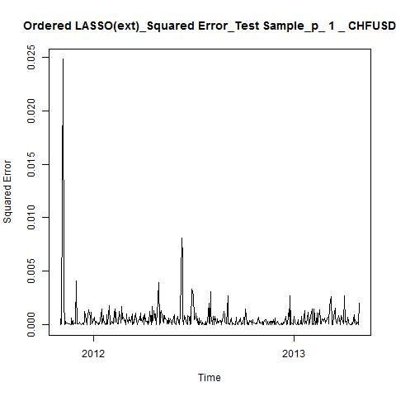
Optimal Lambda ≈ 0.07
Optimal Lambda ≈ 0.0672055

Slide 29
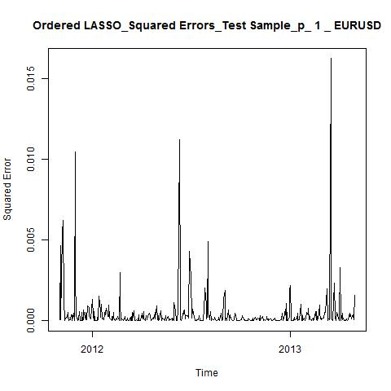
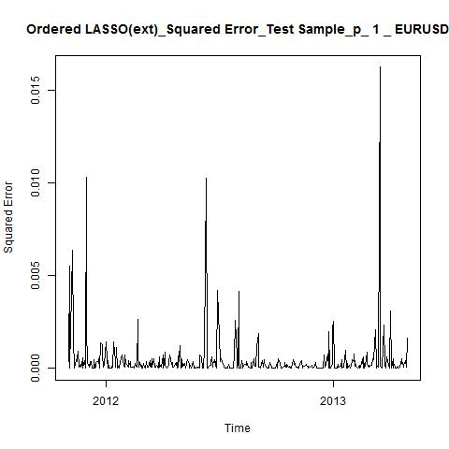
Optimal Lambda ≈ 1.38
Optimal Lambda ≈ 0.0000454

Slide 30
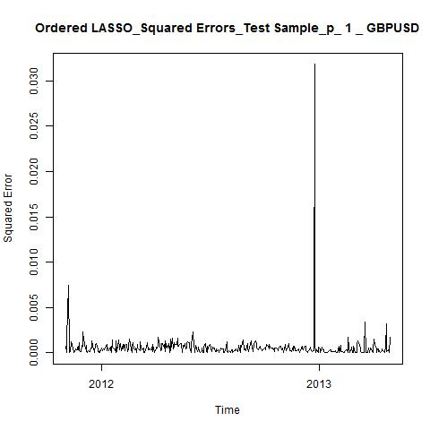
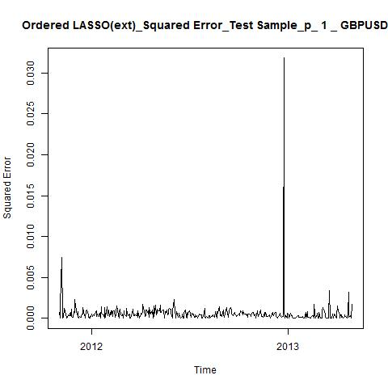
Optimal Lambda ≈ 132
Optimal Lambda ≈ 132

Slide 31
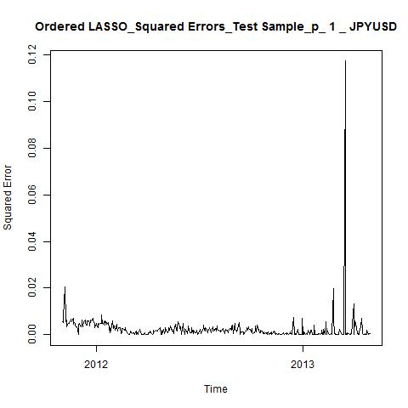
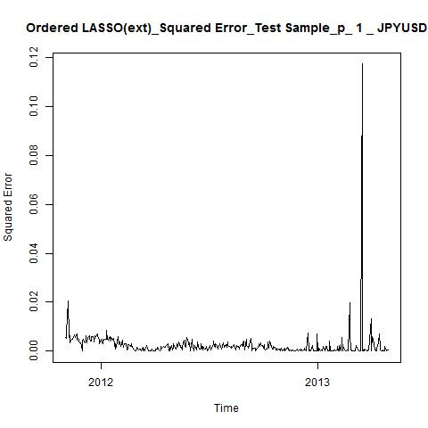
Optimal Lambda ≈ 400
Optimal Lambda ≈ 400

Slide 32
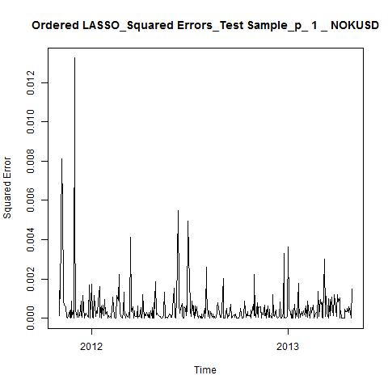
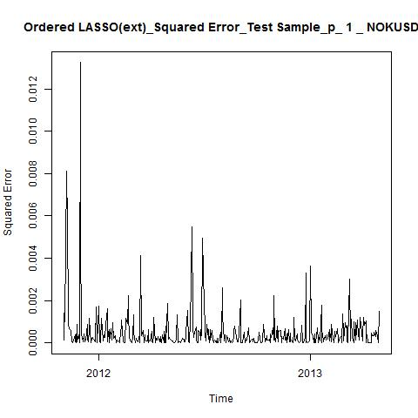
Optimal Lambda ≈ 20
Optimal Lambda ≈ 20

Slide 33
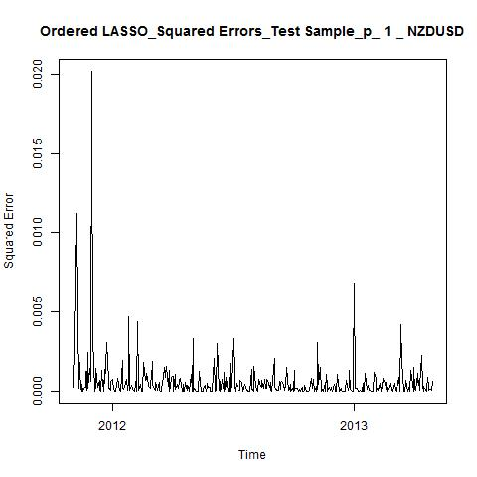
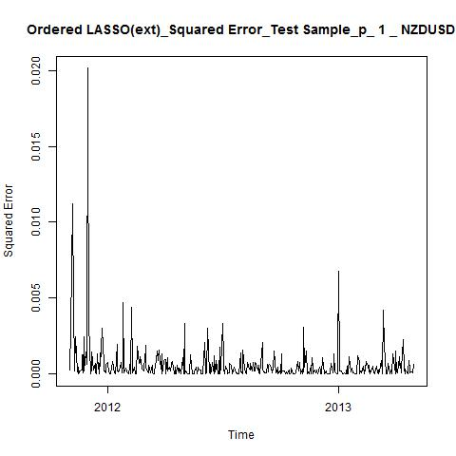
Optimal Lambda ≈ 0.01
Optimal Lambda ≈ 0.0000454

Slide 34
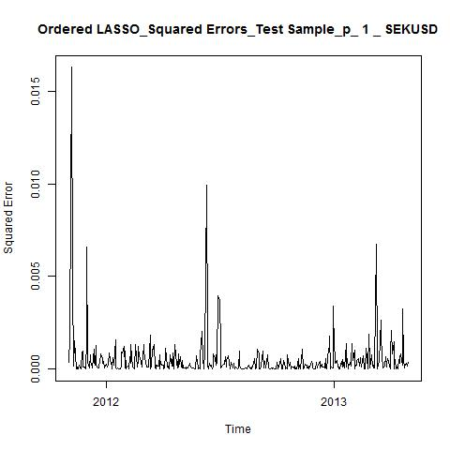
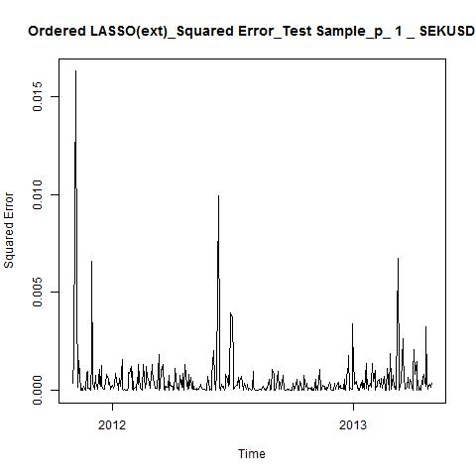
Optimal Lambda ≈ 23
Optimal Lambda ≈ 23

Slide 35
P=2

Slide 36
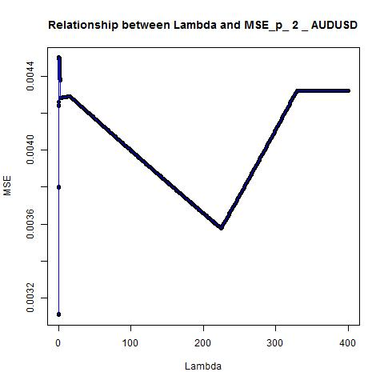
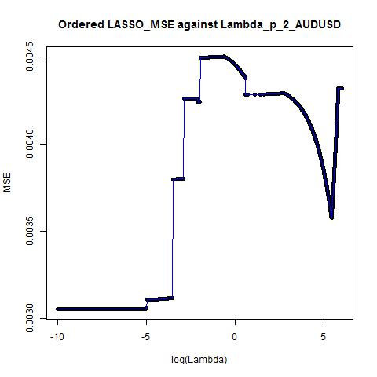
Optimal Lambda ≈ 0.01
Optimal Lambda ≈ 0.0000454

Slide 37


Optimal Lambda ≈ 206
Optimal Lambda ≈ 0.0223708

Slide 38


Optimal Lambda ≈ 0.48
Optimal Lambda ≈ 0.0000454

Slide 39


Optimal Lambda ≈ 0.92
Optimal Lambda ≈ 0.9512294

Slide 40


Optimal Lambda ≈ 0.03
Optimal Lambda ≈ 0.0287246

Slide 41


Optimal Lambda ≈ 0.08
Optimal Lambda ≈ 0.0780817

Slide 42


Optimal Lambda ≈ 0.03
Optimal Lambda ≈ 0.0301974

Slide 43


Optimal Lambda ≈ 0.01
Optimal Lambda ≈ 0.0000454

Slide 44


Optimal Lambda ≈ 0.01
Optimal Lambda ≈ 0.0000454

Slide 45


P=2

Slide 46


Optimal Lambda ≈ 0.01
Optimal Lambda ≈ 0.0000454

Slide 47


Optimal Lambda ≈ 206
Optimal Lambda ≈ 0.0223708

Slide 48


Optimal Lambda ≈ 0.48
Optimal Lambda ≈ 0.0000454

Slide 49


Optimal Lambda ≈ 0.92
Optimal Lambda ≈ 0.9512294

Slide 50

Optimal Lambda ≈ 0.03
Optimal Lambda ≈ 0.0287246

Slide 51


Optimal Lambda ≈ 0.08
Optimal Lambda ≈ 0.0780817

Slide 52


Optimal Lambda ≈ 0.03
Optimal Lambda ≈ 0.0301974

Slide 53


Optimal Lambda ≈ 0.01
Optimal Lambda ≈ 0.0000454

Slide 54


Optimal Lambda ≈ 0.01
Optimal Lambda ≈ 0.0000454

Slide 55
P=3

Slide 56


Optimal Lambda ≈ 0.01
Optimal Lambda ≈ 0.006097

Slide 57


Optimal Lambda ≈ 0.03
Optimal Lambda ≈ 0.023518

Slide 58


Optimal Lambda ≈ 0.03
Optimal Lambda ≈ 0.022371

Slide 59


Optimal Lambda ≈ 0.04
Optimal Lambda ≈ 0.035084

Slide 60


Optimal Lambda ≈ 178
Optimal Lambda ≈ 0.012277

Slide 61


Optimal Lambda ≈ 0.43
Optimal Lambda ≈ 0.070651

Slide 62


Optimal Lambda ≈ 0.08
Optimal Lambda ≈ 0.074274

Slide 63


Optimal Lambda ≈ 0.01
Optimal Lambda ≈ 0.006097

Slide 64


Optimal Lambda ≈ 0.01
Optimal Lambda ≈ 0.005517

Slide 65


P=3

Slide 66


Optimal Lambda ≈ 0.01
Optimal Lambda ≈ 0.006097

Slide 67


Optimal Lambda ≈ 0.03
Optimal Lambda ≈ 0.023518

Slide 68


Optimal Lambda ≈ 0.03
Optimal Lambda ≈ 0.022371

Slide 69


Optimal Lambda ≈ 0.04
Optimal Lambda ≈ 0.035084

Slide 70


Optimal Lambda ≈ 178
Optimal Lambda ≈ 0.012277

Slide 71


Optimal Lambda ≈ 0.43
Optimal Lambda ≈ 0.070651

Slide 72


Optimal Lambda ≈ 0.08
Optimal Lambda ≈ 0.074274

Slide 73


Optimal Lambda ≈ 0.01
Optimal Lambda ≈ 0.006097

Slide 74


Optimal Lambda ≈ 0.01
Optimal Lambda ≈ 0.005517

